Slide 2
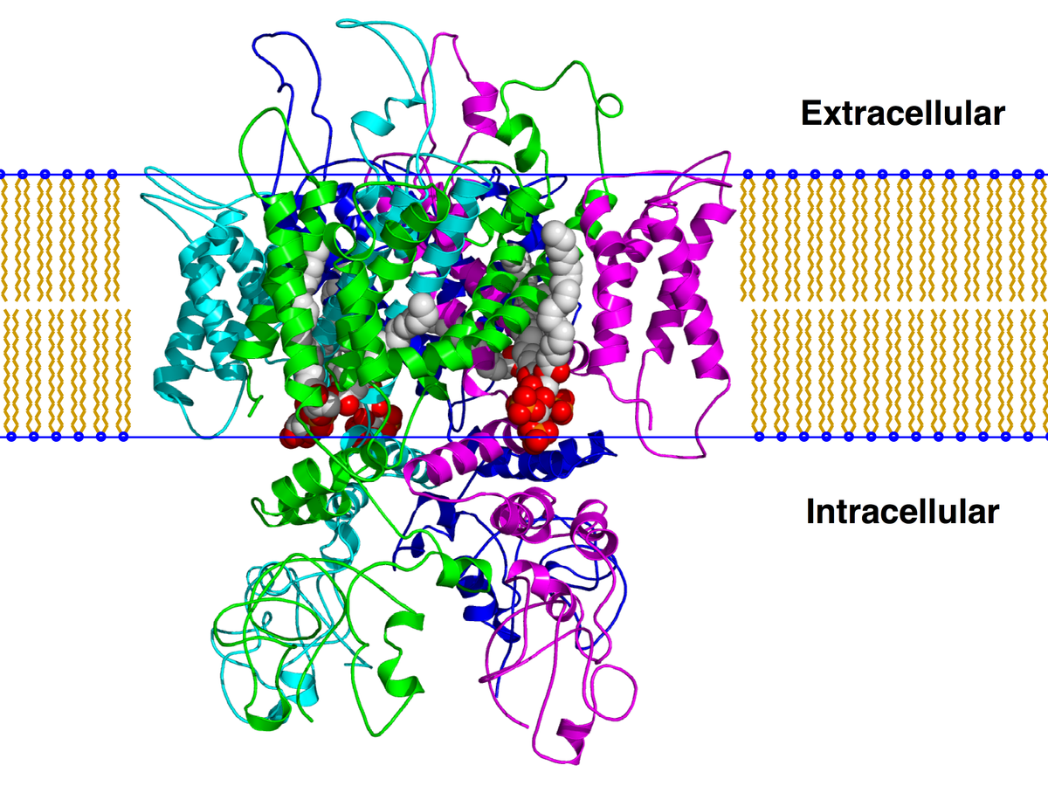
TRPV-1 Channel

Slide 3
Excitable Cells
Dr Paolo Actis
p.actis@leeds.ac.uk

Slide 4
Why is it important
Action Potential 1963 Nobel Prize
Patch Clamp technique 1991 Nobel Prize
Sodium-Potassium Pump 1997 Nobel Prize
Potassium leak channel 2003 Nobel Prize
Ion channel receptors for temperature and touch 2021 Nobel Prize

Slide 5
 | Concentration (mM)
Ion | Intracellular | Extracellular
Human cell
K⁺ | 150 | 5
Na⁺ | 5-15 | 145
Cl⁻ | 4 | 110
Ca²⁺ | 0.0001 | 2.5-5

Slide 6
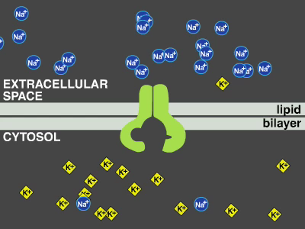

Slide 7
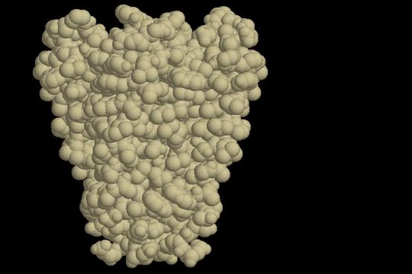

Slide 8
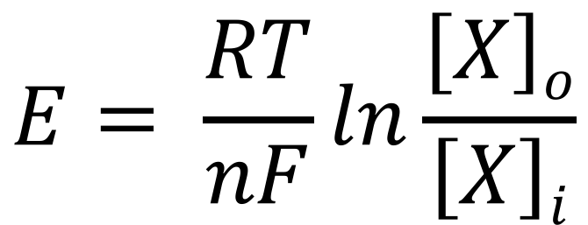
Nernst Equation
$$E= \frac{RT}{nF}ln\frac{\left[X\right]o}{\left[X\right]i}$$
R is the universal gas constant and is equal to 8.314 J.K⁻¹.mol⁻¹
T is the temperature in Kelvin
n is the valence of the ionic species
F is the Faraday's constant and is equal to 96,485 C mol⁻¹

Slide 9
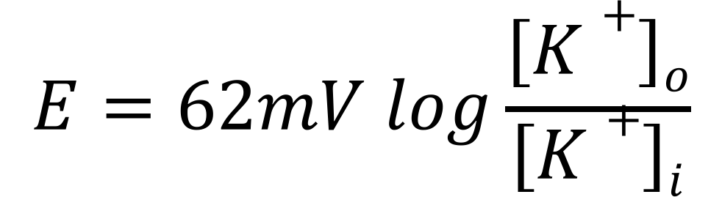
Nernst Equation for Potassium (K⁺)
$$E=62mV log\frac{\left[K+\right]o}{\left[K+\right]i}$$

Slide 10
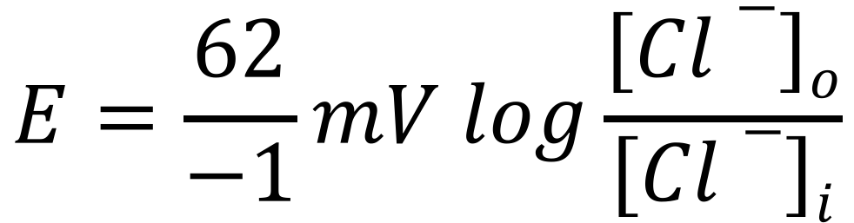
Nernst Equation for Chloride (Cl⁻)
$$E=\frac{62}{−1}mV log\frac{\left[Cl−\right]o}{\left[Cl−\right]i}$$
Because the Chloride ion carries 1 negative charge

Slide 11
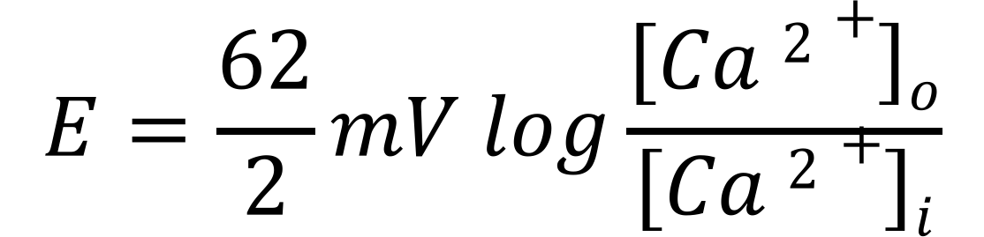
Nernst Equation for Calcium (Ca²⁺⁾
$$E=\frac{62}{2}mV log\frac{\left[Ca 2+\right]o}{\left[Ca 2+\right]i}$$
Because the Calcium ion carries 2 charges

Slide 12
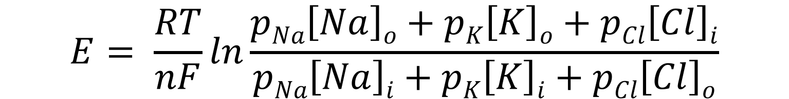
GHK Equation
$$E= \frac{RT}{nF}ln\frac{pNa\left[Na\right]o+pK\left[K\right]o+pCl\left[Cl\right]i}{pNa\left[Na\right]i+pK\left[K\right]i+pCl\left[Cl\right]o}$$
R is the universal gas constant and is equal to 8.314 J.K⁻¹.mol⁻¹
T is the temperature in Kelvin
n is the valence of the ionic species
F is the Faraday's constant and is equal to 96,485 C mol⁻¹
p ion permeability

Slide 13
Typical Ion Concentrations
 | Concentration (mM)
Ion | Intracellular | Extracellular
Squid Axon
K⁺ | 400 | 10
Na⁺ | 50 | 440
Cl⁻ | 40-150 | 560
Ca²⁺ | 0.0001 | 10
 | Concentration (mM)
Ion | Intracellular | Extracellular
Mammalian cell
K⁺ | 150 | 5
Na⁺ | 5-15 | 145
Cl⁻ | 4 | 110
Ca²⁺ | 0.0001 | 2.5-5
p_{K}:p_{Na}:p_{CL} = 1:0.05:0.45

Slide 14
Action Potential

Slide 15
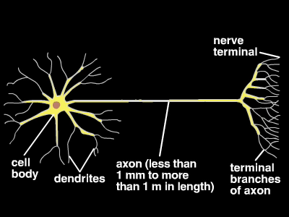

Slide 16
The Squid giant axon

Slide 17
Action Potential

Slide 18
Patch Clamp Technique

Slide 19
Electromyography (EMG)
EMG is a technique for evaluating and recording the electrical activity produced by skeletal muscles
The signal above is produced by the sum of action potentials from the muscle fibres under the electrodes

Slide 20
Nature, 2017

Slide 22
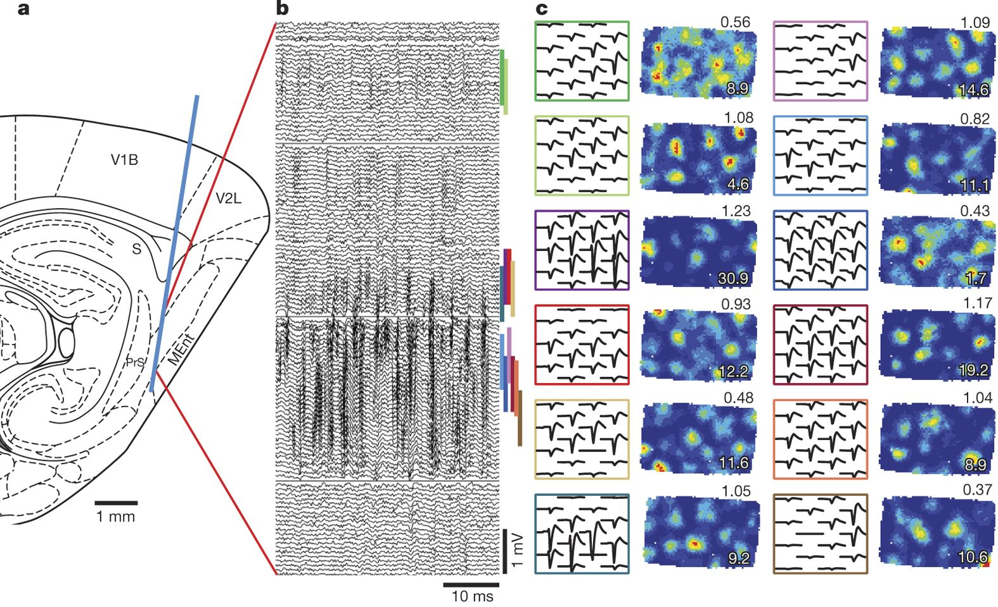

Slide 23
Neuron, 2016

Slide 24
Neuron, 2016

Slide 25
If you want to read more:
Membrane Potential : Khan Academy https://goo.gl/ttKeSE
Action Potential: Khan Academy https://goo.gl/6zrsro
To practice with the Nernst Equation https://goo.gl/b8e9fw
Labster Labs: Sensory Transduction and Action Potential Lab
To read more about the Patch Clamp technique https://www.leica-microsystems.com/science-lab/the-patch-clamp-technique
Books: Essential Cell Biology (Alberts, Bray, Johnson et al)

